Slide 1
Developing Office Add-Ins
with Angular 2
Scot Hillier
scot@scothillier.net
@ScotHillier

Slide 2












Scot Hillier
www.itunity.com/users/scot-hillier
www.criticalpathtraining.com
scot@scothillier.net
@ScotHillier
www.microsoftvirtualacademy.com/Studies/SearchResult.aspx?q=hillier
channel9.msdn.com/Search?term=hillier#ch9Search
www.pluralsight.com/search/?searchTerm=hillier

Slide 3
Agenda
Office Add-In architecture
The JavaScript API for Office
Angular 2 and Office add-ins
The Office UI Fabric

Slide 4
Office Add-In Architecture

Slide 5
What is an Office Add-in?
Web application loaded inside an Office Application
Embedded inline or as task pane within documents, mails or appointments.
Works in Office Applications such as Microsoft Outlook
Works in Office Web Applications such as OWA
Works in mobile Office clients
Office application extensions using Web technologies
HTML 5 and CSS used to construct user interface
JavaScript used to add executable logic and event handlers
Add-in can provided code to read/write content to/from Office documents
Add-in can call Web services hosted over Internet or running within local network
Notes:
An Office Add-in can be seen as a Web page loaded inside an Office Application. In some cases it will appear embedded inline within the document. In other cases it might appear as a task pane or within a message in Outlook. Note that the architecture for Office Add-ins has been designed to work in both Office Applications and Office Web Applications.
Office Add-ins allow Office applications to be extended in such as way so that they can leverage Web technologies such as HTML 5 and CSS for rendering user interface as well as JavaScript and jQuery to add behavior. When you write the JavaScript code for an Office Add-in, you can call REST APIs such as those added to SharePoint 2013 to retrieve and update data from across network.

Slide 6

Anatomy of an Office Add-in
Each Office Add-in is based on XML-based manifest
Manifest points to a Web page
Manifest defines the type of the Office Add-in
Manifest defines which Office applications it supports
Manifest defines required capabilities
Office Add-in
Office Add-in
Manifest
<XML>
Web
Page
HTML+JS
Notes:
Every App for Office must be distributed with an XML-based manifest which contains information about the app itself. For example, the app manifest contains an address to a Web page on the Internet which is used to load the app. The app manifest also includes information which indicates which Office applications it supports. The app manifest also defines the required capabilities which represent the set of permissions that the app needs in order to run and complete its work.

Slide 7



Designing Office Add-ins - Shapes
Office Add-ins come in different shapes
Task Pane Add-in
Content Add-in
Mail Add-in
Mail Compose Add-in
Word Application
Excel Application
Outlook Application
Outlook Application
Document
Task Pane App
Document
Inbox
Selected Message
Inbox
New Message
Mail Compose
App
Reply | Reply All | Forward
To: xxx@yyy.com
Subject: Top secret stuff
app
Mail App
Content App
Message Body
Message Body
Notes:
When you begin to design an app, you must pick one of the three different shapes. You can create a document-based app as either a Task Pane App or a Content App. Alternatively, you can create a Mail App that targets Outlook and Outlook OWA.

Slide 8
Office add-in archtecture
SharePoint Online
Azure
Office
Azure Data Market
html
CSS
js
html
CSS
js

Slide 9
DEMO
Using an Outlook add-in

Slide 10
The JavaScript API
for Office

Slide 11
Referencing the JavaScript API for Office
Implemented in office.js
Referenced from a CDN
https://appsforoffice.microsoft.com/lib/1/hosted/Office.js
Provides the Office object as entry point
Recently enhanced by Microsoft to include new Word and Excel functionality in objects

Slide 12
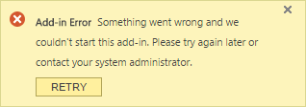
Initializing the add-in
When API is loaded and ready Office.initialize event fires
The event MUST be handled by add-in within 5 seconds
Each page in the add-in must handle the event
Failure to handle the event within 5 seconds causes an error
Office.initialize = function (reason) {
//code
};

Slide 13
The Context object
Provides access to the runtime context
Office.context.document accesses the current document
Word
Excel
PowerPoint
Project
Office.context.mailbox accesses the current user’s mailbox
Outlook

Slide 14
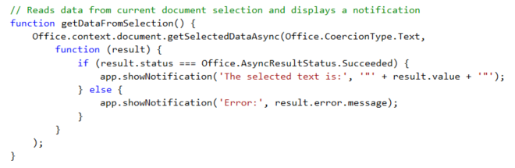
Office.context.document
Notes:
The function getSelectedDataAsync() is used to read content from the selected region of the current Word document.

Slide 15
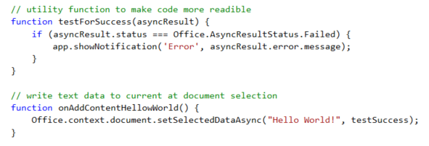
Office.context.document
Notes:
The function setSelectedDataAsync is used to write content into the selected region of the current document. If there is no selected region, the content is added at the location of the cursor.

Slide 16
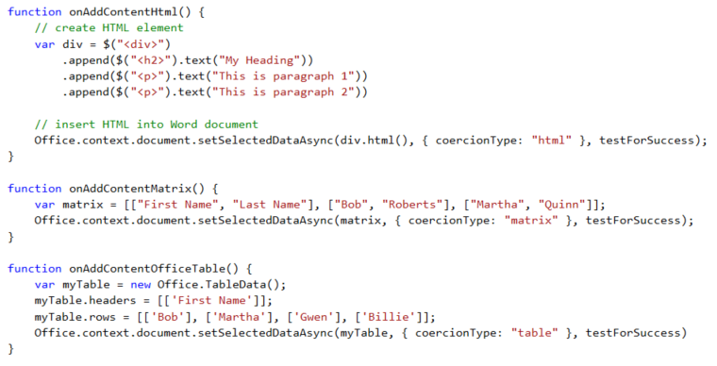
Coercion Types
Coercion types make it possible to read/write content in different formats
text - string value
html - HTML content
matrix - array of arrays
table - table of rows and columns
ooxml - Office Open XML format

Slide 17
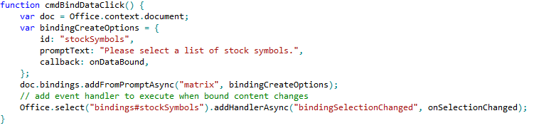
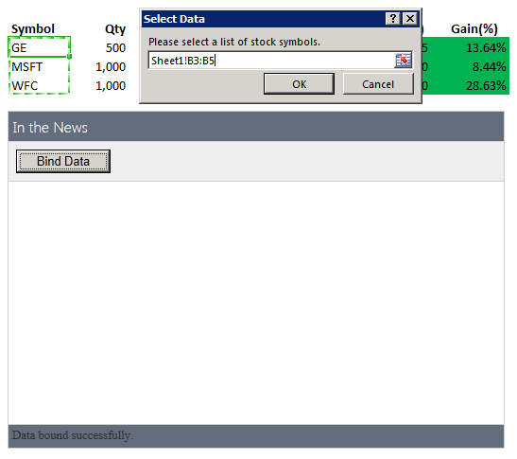
Bindings
Adding a binding
Bindings.addFromPromptAsync
Bindings.addFromSelectionAsync
Bindings.addFromNamedItem
Referencing a binding
Bindings.getAllAsync
Bindings.getByIdAsync
Office.Select
Removing a binding
Bindings.releaseByIdAsync
Binding event handler to a binding
Binding.addHandlerAsync(“type”, handler);
A dialog is presented to the user experience when you call addFromPromptAsync.
Notes:
To add a binding, you should use one of the following method
Bindings.addFromPromptAsync
Bindings.addFromSelectionAsync
Bindings.addFromNamedItem
You will also need to reference bindings to read and write content and register event handlers. When you need to reference a binding, you can use one of these method.
Bindings.getAllAsync
Bindings.getByIdAsync
Office.Select
If you ever need to remove a binding, you can use this methods.
Bindings.releaseByIdAsync
To register an event handler on a binding, you can use the following method.
Binding.addHandlerAsync(“type”, handler);

Slide 18
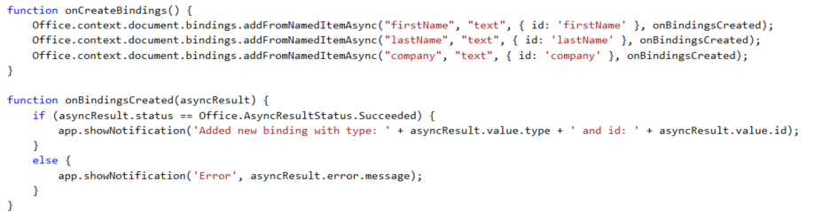

Adding Bindings in JavaScript
Notes:
The top code listing shows how to create bindings in JavaScript code using addFromNamedItemAsync. Note that the first parameter (e.g. "firstName") is used to indicate which content control you want to bind to. The third argument (e.g. { id: 'firstName' } is used to create the binding ID that will be used to retrieve the binding when call the Office.select function.
Note that the call to Office.select gets the binding using a syntax of "bindings#" followed by the ID of a registered binding.

Slide 19
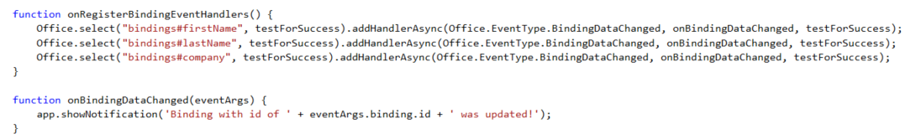
Event Handlers
Event handlers added using addHandlerAsync
Callback function called automatically when user updates binding content
Notes:
This code shows how to register an event handler on a binding using the addHandlerAsync function.
The call also registers a callback function named onBindingDataChanged which is called automatically when user updates the bound content.

Slide 20
New Office 2016 APIs
Batching
Multiple API execution requests can be queued (batched) and executed at once
Promises Syntax
Helps manage complex and nested callback flows in a simple manner
Object Oriented Design
Enables a friendlier syntax for interacting with complex object hierarchies/graphs
Selective Loading
Allows for efficient execution (only necessary properties/objects are marshalled)
Service-compatible
Allows for REST API equivalents with shared interface contracts

Slide 21
New Word APIs
CRUD and navigation of a Word doc’s core elements
Rich text and paragraph formatting
External data binding through content controls
Rich search and selection
Insert pictures and other documents

Slide 22
The Run and Sync methods
Run returns a promise and provides object tracking
Sync synchronizes code changes with the underlying document

Slide 23
The Run and Sync methods
Excel.run(function (ctx) {
var range = ctx.workbook.worksheets.getActiveWorksheet().getRange('A1:B2');
range.load("address, values, range/format");
return ctx.sync().then(function () {
//success
});
}).then(function () {
//done
}).catch(function (error) {
//error
});

Slide 24
DEMO
Snippet Explorer

Slide 25
Angular and Office Add-Ins

Slide 26
Introducing Angular 2
Description
Single-Page Application (SPA) Framework
Implements MV* (pronounced M-V-star) Pattern
Why Angular
True framework instead of patchwork of libraries
Strong separation of concerns
Why Angular 2
Significant improvements in speed
Supports latest JavaScript innovations like components, modules
Better mobile support

Slide 27
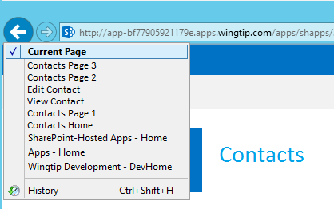
Single-Page Applications
App has one page
Different views are loaded dynamically
Routes are used to simulate pages
History list reflects route navigation
Id
First Name
Last Name
Id
1
First Name
Scot
Contacts.html
Last Name
Hillier

Slide 28
MV* with Angular 2
View
Component
Data
Model

Slide 29
Angular Building Blocks
Modules and Barrels
Components and Directives
Templates and Binding
Services and Dependency Injection

Slide 30
Modules and Barrels
//module
export class Welcome {
public static getMessage() {
return 'Hello, World!';
}
}
custom module
import module
//component
import {Welcome} from './app.module'
import {Component} from 'angular2/core'
Import barrel

Slide 31
Components and Directives
import {Welcome} from './app.module'
import {Component} from 'angular2/core'
@Component({
selector: 'app-main',
template: `<h1>${Welcome.getMessage()}</h1>`
})
export class AppComponent { }
Component associates HTML template with CSS selector
<tr *ngFor="#item of items">
<td>{{item.Title}}</td>
<td>{{item.Body}}</td>
</tr>
Structural directive adds elements to DOM
Attribute directive alters existing elements
<div [(ngModel)]="welcomeMessage"></div>

Slide 32
Templates and Binding
<!-- interpolation -->
<div>{{welcomeMessage}}</div>
<!-- property binding -->
<button [disabled]="isWorking"></button>
<!-- event binding -->
<button (click)="buttonClicked()"></button>
<!-- two-way binding -->
<input [(ngModel)]="firstName"/>
<!-- directives -->
<div [ngClass]="'byline'">{{author}}</div>
<my-directive [myProperty]="'an expression'"></my-directive>
<!-- attribute binding -->
<button [attr.aria-label]="actionName">Aria</button>

Slide 33
Services and Dependency Injection
export class SimpleService {
constructor() { }
getMessage() { return "Hi!"; }
}
Create the service
import {Component} from 'angular2/core'
import {SimpleService} from './simple.service'
@Component({
templateUrl: '/app/templates/simple.html',
providers: [SimpleService]
})
export class SimpleComponent {
welcomeMessage: string;
constructor(simpleService: SimpleService) {
this.welcomeMessage = simpleService.getMessage();
}}
Inject the service

Slide 34
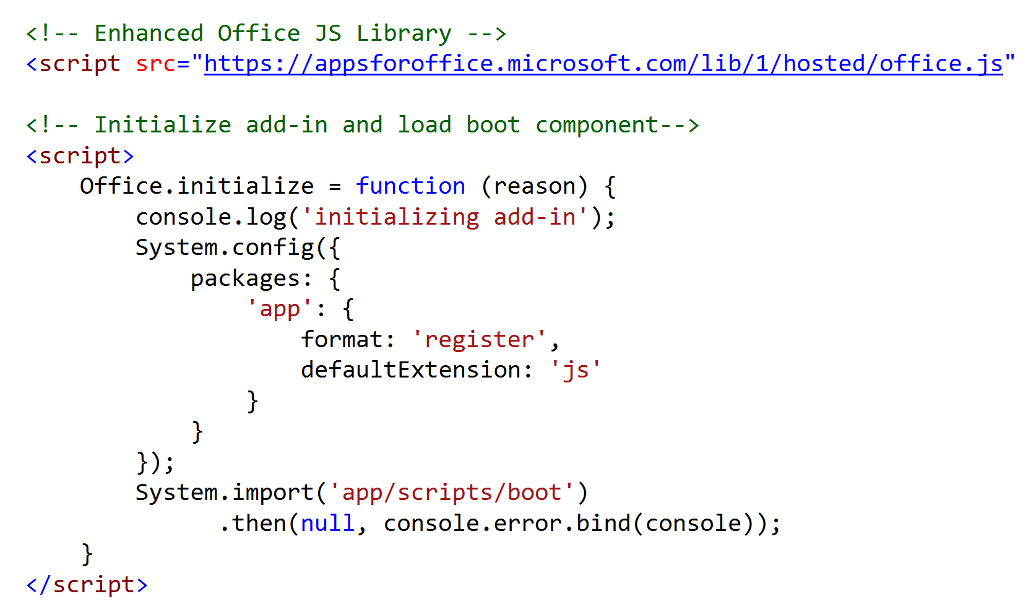
Office.js and Angular
Office.js initialization must happen in first 5 seconds

Slide 35
DEMO
Office add-in with Angular 2

Slide 36
The Office UI Fabric

Slide 37
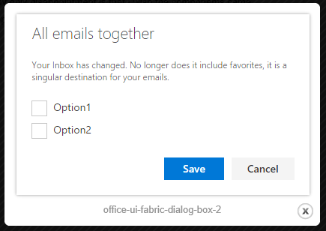
Introducing the Office UI Fabric
10 base font classes representing Office typography
9 different themes
Localization support
12-column responsive grid structure
26 components
Menus
Breadcrumbs
Buttons
Tables
More…

Slide 38
Using the Office UI Fabric
Add references to the style sheets
Apply styles
Utilize HTML from pre-defined components
<link rel="stylesheet" href="https://appsforoffice.microsoft.com/fabric/1.0/fabric.min.css">
<link rel="stylesheet" href="https://appsforoffice.microsoft.com/fabric/1.0/fabric.components.min.css">

Slide 39
DEMO
The Office UI Fabric

Slide 40
Agenda
Office Add-In architecture
The JavaScript API for Office
Angular and Office add-ins
The Office UI Fabric

Slide 41
References
IT Unity Articles
http://www.itunity.com/article/building-excel-2016-addin-angular-enhanced-officejs-2637
http://www.itunity.com/article/office-ui-fabric-angular-js-create-office-addin-2570
Office JavaScript APIs
https://github.com/OfficeDev/office-js-docs
Snippet Explorer
https://github.com/OfficeDev/office-js-snippet-explorer
Office UI Fabric
https://github.com/OfficeDev/Office-UI-Fabric/blob/master/ghdocs/FEATURES.md

